Slide 1

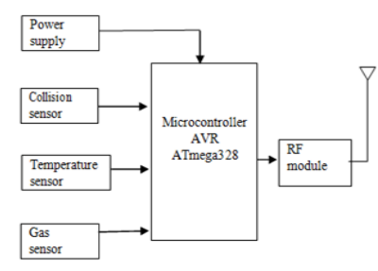
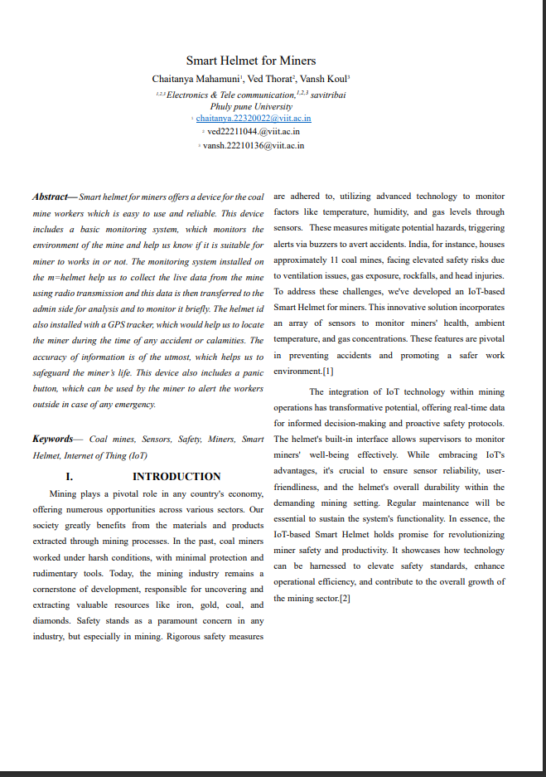
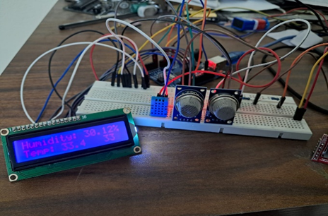
Smart Helpmate for Miners
Chaitanya Mahamuni, Ved Thorat,Vansh Koul
SY BTech, AY 2023-24 SEM-II, Course: Microcontroller And Application
Under the Guidance of: Dr. Pravin G. Gawande
Introduction
Block diagram
Results
PNAS Author Center
The main aim of our project is to alert people and take safety measure during mining . To detect the and monitor factors like temperature ,humidity, and gas leak through sensors
The project involves an MQ2 sensor to detect the presence of smoke and other gases and electronic circuit to process .
This system comprises 8051 microcontroller sensors and 16 *2 LCD .
When the gas sensor MQ5 detects the gas level of the surrounding environment in the transmitter section, if it is high level of hazardous or dangerous gases then the transmitter section sends “GAS DETECTED” alert signal to helmet, then the helmet shows status on the LCD, as well as buzzer is activated.
Methodology
This project has two section. They are transmitter section and receiver section. The transmitter section consists of ATmega328 microcontroller, collision sensor, MQ5 gas sensor, humidity sensor and RF transmitter. In receiver section, ATmega328 is interfaced with buzzer, LCD Display and RF receiver. The transmitter section is placed in the underground mining areas. In transmitter section, collision sensor, MQ5 gas sensors and humidity sensor are interfaced with ATmega328 microcontroller and then ATmega328 microcontroller connected with RF transmitter. The humidity sensor, gas sensor and collision sensor collect information and send it to receiver section through RF transmitter.
The receiver section is placed on the person’s helmet. In receiver section, buzzer and LCD display is interfaced with ATmega328 microcontroller and RF receiver also connected with ATmega328 microcontroller. The transmitted information from RF transmitter is received by using RF receiver. If the detected values are higher than pre-defined limit, then buzzer gives warning signal and LCD display shows status. The advantage of placing transmitter section on the underground mining areas, we can know gases level and temperature level of that transmitter section placed area before we can go in there. The another advantage we don’t need sensors to be placed in every individual person’s helmet
Hardware Setup
The smart system divided into two parts. The transmitter part consists of Arduino, DHT11 sensor, MQ 02 gas sensor, LoRa communication, GSM sim800a, Vibration sensor, IR sensor, power supply, The receiver part consists of LoRa communication, Microcontroller , power supply, laptop.
1. MQ 02 the Gas sensor is used to detect the levels of poisonous gas in the mine. If the value is greater than 990 ppm it sends a message saying “gas alert”.
2. DHt11 detects the temperature and humidity. If the value of temperature is greater than 36 it sends a message saying “temperature alert”. If the value of humidity is greater than 94 it sends a message saying “humidity alert”
3. Vibration sensor detects sudden changes in movements. If c==0 it sends a message saying “vibration alert”.
4. IR sensor detects the obstacles and these sensors are interfaced with Arduino. If b==1 it sends a message saying “obstacle alert”.
5. The threshold for each of the readings of these sensors is set and if any value crosses the threshold, a buzzer is activated and alerts are sent to the receiver module and the mobile phone.
6. The receiver part receives the alerts along with mobile phone and specific action will be taken.
Conclusion
The smart helmet for miners has been designed specifically for coal miners. The helmet is capable of detecting a range of events that occur inside the mines, the events that could be dangerous for the life of a miner. Some events and accidents go unrecognized by the workers outside the mines because of lack of information of what goes under the mine. The helmet will help the workers outside the mine to keep a close eye on what is the condition under the mine and if it is suitable for a miner .
To work under or not. The helmet gives a live status of different parameters like temperature under the mine, presence of any poisonous gases. Along with this the helmet has a GPS module, so that one can easily locate the miner’s location under the mine and can be rescued in time. The panic button attached to the helmet helps miners to ask for help in case of any accident, the miner can simply press the button once that would warn the workers outside the mines. The IR sensors enable us to know if the miner is wearing the helmet or not. The helmet is a low-cost, efficient and reliable prototype designed and tested properly
References
[1] Tatham’ , ‘Puja G. Punchcutter’, “A Microcontroller Based smart helmet for coal miners for air quality and hazardous event detection”, Volume 4 Issue-3,2018.
[2] Hem Chandra Joshi and Satyajit Das, “Design and Simulation of Smart Helmet for Coal Miners using Zigbee Technology”, International Journal on Emerging Technologies (special issue NCETST-2017).
[3] Chandrashekar S,Dr. Sarika Tale, “An Intelligent Ultrasonic Helmet System for Miner, International Journal of Engineering Research & Technology (IJERT), Special Issue-2017.
[4] Beena M Varghese, Binisha Balan, Neethu Varghese, Reshma Gangadharan , Shaima, “Intelligent safety system for coal miners”, In
BRACT’S, Vishwakarma Institute of Information Technology, Pune-48
Department of Electronics and Telecommunication Engineering
(An Autonomous Institute affiliated to Savitribai Phule Pune University)
(NBA and NAAC accredited, ISO 9001:2015 certified)

